Slide 1
Data Mind – {Logo+Punchline TM}

Slide 2
Class 1: Table of Contents
Intro to the course :
About me
Why attend
Soft Pre-requisites
Relevance for becoming a data scientist
Setup your python environment:
As per the installation instructions shared earlier
Install libraries
Python code on a Jupyter notebook using popular libraries
Introduction to Git & Github
Motivation – Code sharing, collaboration
Common commands and use
Python code demo
Python Intro
OOP or why python (vs R)
Properties of OOPL with code example
Features:
Syntax
Speed
Learning curve

Slide 3
Class 1: Intro to the course
About me:
Work experience: 10+ years
Industries: Retail, Pharma, Entertainment, Hi-tech, Telecom
Education : B.Tech – IIT-BHU (2008) and Indian School of Business Hyderabad (2015)
Experienced in: Machine Learning , Computer vision, Deep Learning, Python, R
Goal of this initiative: To help aspiring data scientists get upto speed quickly by focusing on theory and coding based hands on approach. Our focus will remain on what’s important not just from a theory point of view but also what is used in real business today. We will look to understand best of both worlds.
Soft- pre-requisites: Good to have the following, but don’t worry even if there are some areas where you have not had formal education
10th Grade Math
Linear Algebra
Some programming experience in python
List of resources posted on the course Github Repo <<link>>
What you should take away at the end:
A good understanding of various statistical methods and their usage in a variety of business problems
Some intuition of how these methods work
How to apply some/all of these methods together to solve a business problem
How to think as modern age data scientists

Slide 4
Class 1: Setup your Anaconda python environment
What is anaconda?
With over 6 million users, the open source Anaconda Distribution is the easiest way to do Python data science and machine learning.
It includes 250+ popular data science packages and the conda package and virtual environment manager for Windows, Linux, and MacOS. Conda makes it quick and easy to install, run, and upgrade complex data science and machine learning environments like Scikit-learn, TensorFlow, and SciPy.
Python 3.5+ is the way forward – Course platform as well;
Separate environment with python 2.7 can be created
Support for python 2.7 is discontinued
Installation instructions:
Go to : https://www.anaconda.com/download/
Pick Python 3.5+ version (can be python 3.5 or later)
Pick the version based on your OS and Machine
Install Anaconda using default settings
We will create new environment in the class
We will review both GUI and conda CMD prompt based usage in the class
Source: https://www.anaconda.com/what-is-anaconda/

Slide 5
Class 1: Setup your Jupyter python environment
What is a library?
Libraries are pieces of codes already written and compiled by someone else that we can simply borrow and use in our work
Benefits:
Tested, verified, by other users
Saves time
Some important libraries – Numpy, Pandas, Scipy, Seaborn, Matplotlib, Scikit-Learn
Example: Code demonstration on class notebooks hosted on Github <<LINK>>

Slide 6
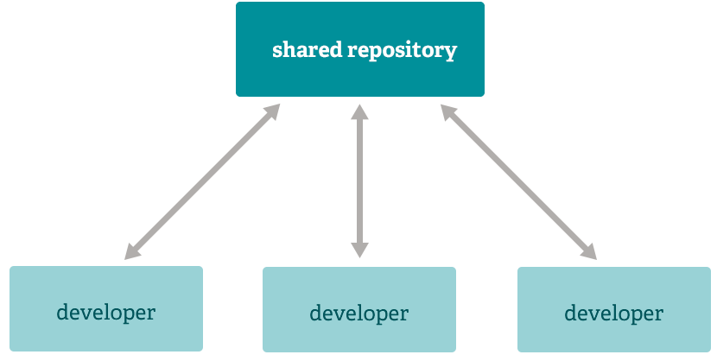
Class 1: Introduction to Git & Github
What is Git?
Git is a free and open source distributed version control system
It basically keeps track of codes and system files
Git allows users to track changes in various computer system files, often code files
Especially useful when many people are coordinating on a single project
Keeps entire history of changes so can revert back to an earlier version if so desired
Users can keep codes at local or remote repos
The typical Git workflow is shown below, wherein multiple developers share and merge code on a single shared repository
Source: https://git-scm.com/about/distributed

Slide 7

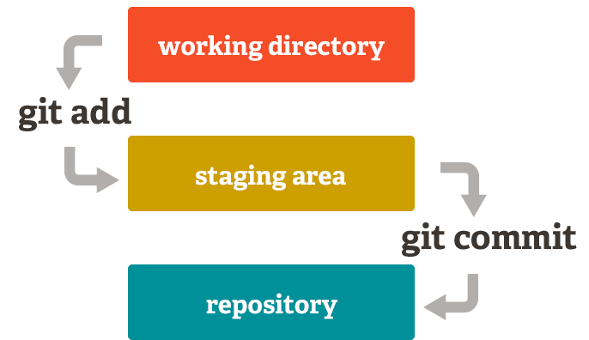
Class 1: Git Basics
Git offers many useful functionalities such as Branching & Merging, Staging area, Commit, Pull, Push etc.
Key Concepts:
Git keeps track of all the code , thereby allowing users to go back to a specific version
Users decide when these “tracking” events occur by committing the codes
Users can merge selective codes by using branching functionality
Flexibility to choose what gets added to the repo (.gitignore)
Branching & Merging:
Git allows and encourages you to have multiple local branches that can be entirely independent of each other.
The creation, merging, and deletion of those lines of development takes seconds
Notably, when you push to a remote repository, you do not have to push all of your branches. You can choose to share just one of your branches a few of them, or all of them
Staging Area:
Git has something called the "staging area" or "index". This is an intermediate area where commits can be formatted and reviewed before completing the commit.
Do review the contents in Additional resources in footnotes for detailed overview of Git
Source: https://git-scm.com/about
Additional Resources: https://git-scm.com/video/what-is-version-control , https://git-scm.com/video/what-is-git , https://git-scm.com/video/get-going , https://git-scm.com/video/quick-wins

Slide 8
Class 1: Getting Started with Git
Git Installation Instructions:
Go to : https://git-scm.com/downloads
Within downloads pick the Git version suitable for your OS and install on your local system
Linux (Debian):
$ sudo apt-get install git
Linux (Fedora):
$ sudo yum install git
The installation install a GUI as well as a command prompt based tool called Git Bash. We will learn to use Git Bash as it more preferred in industry and also since GUI can be easily learned if you have some understanding of Git Bash.
So lets get started with the basic Git commands in the next slide
Source: https://git-scm.com/about

Slide 9
Class 1: Basic Git Commands
Git Command | Type | Usage
$ git config --global user.name "[name]" | User Configuration | Sets the user name that will be used for commits
$ git config --global user.email "[email address]" | User Configuration | Sets the email you want attached to your commit transactions
$ git init [project-name] | Create repo | Creates a new local repository with the specified name
$ git clone [url] | Create repo | Downloads a project and its entire version history
$ git status | Changes | Lists all new or modified files to be committed
$ git add [file] / . (for all) | Changes | Snapshots the file in preparation for versioning in staging area
$ git commit -m "[descriptive message]" | Changes | Records file snapshots permanently in version history
$ git pull / push | Changes | Pull or push changes from or to the remote repo
$ git branch [branch-name] | Groups | Creates a new branch
$ git checkout [branch-name] | Groups | Switches to the specified branch and updates the working directory
$ git merge [branch] | Groups | Combines the specified branch’s history into the current branch
Source: https://services.github.com/on-demand/downloads/github-git-cheat-sheet.pdf, http://ndpsoftware.com/git-cheatsheet.html#loc=remote_repo;

Slide 10
Class 1: Working with remote repo (GitHub)
Create a Github account by going to: https://github.com/
Remember to remember your password as it is required during push/pull operations
Next, demo to create sample code and push to your remote repo on GitHub
Our sample codes will also be shared on the repo for easy accessibility
Create your own repo for these classes, and push your submissions to those repos to practice
Simple git workflow
- Create a project folder on local
- Add files/codes to the local folder
- Git bash on the folder
- git init
- git add . or file
- git status
-create a github repo for this project
- git commit
- git remote add
- git push
If remote repo is not same as local minus changes then git pull first
- git remote add
- git push

Slide 11
Class 1: Intro to python
Python is an open sourced, object oriented programming language with focus on code readability and efficiency
Python is easy to learn due to easy syntax, intuitive commands and can be learned quickly.
Leverage Stackovrflow, Google, python.org in case of code related queries
What is OOP? – Based on concept of objects and methods. In python everything is an object, even a function is an object with attributes.
This leads to highly standardized way of accessing details about objects
Enables class inheritances that reduces code complexity
We will use Python version 3.5 (or later) for the purposes of class

Slide 12
Class 1: Python syntax overview
Syntax governs the way we write codes in a predefined way in a way python interprets it correctly
Lets move to the Python notebook to look at the syntax in practice << LINK>>
Reserved words: Python restricts usage of some words as user objects in order to avoid conflict with internal classes. Such words as called reserve words. We will try not to use these words as names for our objects. Note that these can be used in computation blocks or for simple comparison b/w objects. We just cannot use these as names for our objects.
import keyword
keyword.kwlist
['False', 'None', 'True', 'and', 'as', 'assert', 'break', 'class', 'continue', 'def', 'del', 'elif', 'else', 'except', 'finally', 'for', 'from', 'global', 'if', 'import', 'in', 'is', 'lambda', 'nonlocal', 'not', 'or', 'pass', 'raise', 'return', 'try', 'while', 'with', 'yield']

Slide 13
Class 1: How to load installed libraries
Mostly, we want to import specific modules from a library. Note that a library typically has a ton of useful modules, but usually we don’t need that many for our tasks, but only needs a couple of specific modules.
Let's say we want to import a package foo that defines a class /module Widget:
import foo
will import the foo package; any reference to modules/classes/functions will need to be prefixed with foo.; e.g. foo.Widget
import foo as bar
Will import the foo package with the alias bar; any reference to modules/classes/functions will need to be prefixed with bar.; e.g. bar.Widget
from foo import Widget
can be used to import a specific module/class/function from foo and it will be available as Widget
from foo import *
will import every item in foo into the current namespace; this is bad practice, don't do it.

